Slide 1
Capstone Project- “School Management System”
For the fulfillment of Full Stack Web Development Course
Submitted to,
TechCareer Team
Submitted by,
Bibhuti Ghimire (Bibu)

Slide 2
School Management System
This is a web application designed to help School manage their daily activities
Moderator adds new user to this app. There are 3 kinds of user role
Admin – Admin can add Admin, Teacher, Student, View List of all user, perform CRUD operations, add classes, assign teacher to classes and basically do everything that Moderator can do.
Teacher – Can only add grades, view student details but they do not have right to perform CRUD operation
Student – Can only view their profile, grade sheet and list of their classes.
Visitor– Can only view specific things like News and List of Course Names

Slide 3
SCOPE
The main scope of this application is that “This is a web application designed to help School manage their daily activities”
There might be small school in Edmonton here which just started and need help managing their daily activities. This application can keep track of their teachers, students and admins.
Out of SCOPE
This application does not have
Great CSS
Password Encryption
Google Authentication
Security
Multiple subject added to one student

Slide 4
ADD A NEW MEMBER
logo
Search logo
==
Required input from user
Add new member(Admin/Teacher/Student) below:
*Name
*Email
Moderator and Admin can only add new users. Students and Teachers can not!
*DOB
*username
*password
*Position(Drop Down List)
Moderator
Admin
Teacher
Student
Add New Member

Slide 5
Login Page
logo
Search logo
==
LOGIN
*Username
*Password
Sign In

Slide 6
Admin Page
logo
Search logo
USER LOGIN
View All Student – CRUD operation here
ADMIN is very powerful. They have access to everything and all CRUD Operations
View All Admin – CRUD operation here
View All Teacher – CRUD operation here
View All Course – CRUD operation here
View All Product– CRUD operation here
View All Meeting Request
View All Course – CRUD operation here

Slide 7
Teacher Page
logo
==
View List of Student Here
View Your Classes Here
Add Courses
Request for Transcript (Complete, Incomplete, Delete, Notify)
Request for Meeting (Complete, Incomplete, Delete, Notify)

Slide 8
Student Page
logo
==
View Your Class Names
Request for Transcript
Request for Meeting
View Fee Log and Pay Fee
Access to Inbox to receive Message
Have access to Wallet
Buy product and pay for it

Slide 9
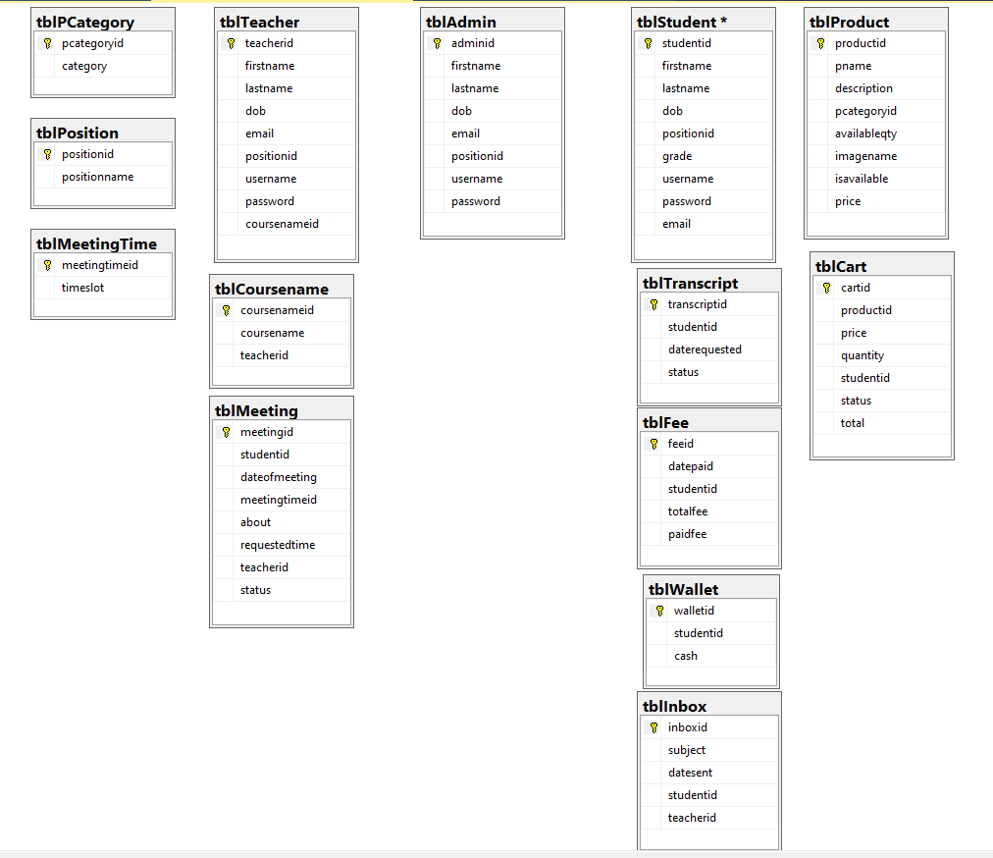
TABLES

Slide 10
THANK YOU!!!!!!!

